Slide 2
Do Now
(require 2htdp/image)
(define FRAME
(empty-scene 300 300))
(define BLUE-REC
(rectangle 200 100 “solid” “blue”))
(place-image BLUE-REC
FRAME)
?
?

Slide 3
Objective
Knowledge
What is the DRY principle?
How can arithmetic expressions aid in programming images?
Skills
Use image properties with arithmetic expressions to program images.

Slide 4
Which function?

Slide 5

What coordinates?
(define CAT )
(define BLUE
(rectangle 100 75
“solid” “blue”))
(overlay/xy CAT
BLUE)
Notes:
do we need the coordinates? what are the dimensions of cat?

Slide 6
What coordinates?
(define CAT )
(define BLUE
(rectangle 100 75
“solid” “blue”))
(overlay/xy CAT
BLUE)
(/ (image-width CAT) 2)
Notes:
do we need the coordinates? what are the dimensions of cat?

Slide 7
Vexillology
is the "scientific study of the history, symbolism and usage of flags or, by extension, any interest in flags in general".

Slide 8
Flag
canton
hoist
fly
staff

Slide 9
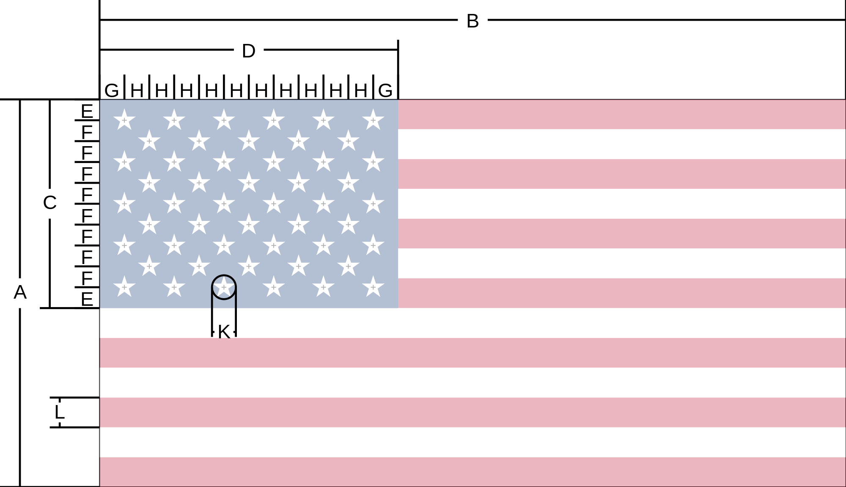
United States
Hoist (width) of flag 1.0
Fly (length) of flag 1.9:
Hoist (width) of Union 0.5385( 7/13):
Fly (length) of Union 0.76:
Diameter of star 0.0616:
Width of stripe 0.0769( 1/13):

Slide 10
Flag of USA specifications
Hoist (height) of the flag: A = 1.0
Fly (width) of the flag: B = 1.9

Slide 11
; make-color : Num Num Num (Num) -> color
(circle 50 “solid” “red”)
“is the same as”
(circle 50 “solid” (make-color 255 0 0))

Slide 12
Hex to Decimal
Old Glory Blue 0x3C3B6E
Old Glory Red 0xB22234

Slide 13
Hex to Decimal
Old Glory Blue 0x3C 3B 6E
3*16 + 12*1
60

Slide 14
Hex to Decimal
Old Glory Blue 0x3C 3B 6E
3*16 + 11*1
60 59

Slide 15
Hex to Decimal
Old Glory Blue 0x3C 3B 6E
6*16 + 14*1
60 59 110

